Slide 1
Security Engineering 101 Ethical Hacking
Mrinal Wahal
IIT Madras, Research Park

Slide 2
Academic Researchers Vs. Industry Experts

Slide 3
Lessons I learned the Hard Way !
Windows == Sucks & Linux == Rocks.
Programming elevates your advantages.
C|EH != Real Hacking & CISSP == Real Hacking.
Thou can never learn entire field of Security.
Knowledge of Networking is Paramount.

Slide 4
Agendas
Foot Printing
Scanning -- NMap
Enumeration
System Hacking -- Metasploit
Phishing -- Social Engineering Toolkit
Steganography
Proxies
Internet Protocol
Malware & viruses
Trojan
Sniffing
Cryptography

Slide 5
Languages Required
Python [ 2.7 or above]
Ruby
Shell Scripts
Perl
C/C++

Slide 6
Foot Printing
In layman terms...
Foot-Printing is collecting much information about target & victim website, organization or a particular Network.

Slide 7
Location
By using Google earth
By using satellite picture
By using Google map

Slide 8
Information about websites/webpages
www.yougetsignal.com
Domain name
IP Address
Place
Server name
Network block
TCP & UDP service

Slide 9
Information about people
Pipl.com
Intelius.com
Bestpeoplesearch.com
Anywho.com
Peoplefinder.com
Webextrator.com
Binarypool.com
Robtex.com

Slide 10
Search engine machine
Google.com
Bing search bar
Yahoo search bar
Facebook
Twitter

Slide 11
How to protect yourself
Don’t register in any website
Don’t come with your real name and identity to internet
Don’t trust anyone in internet
Don’t post your photo & video in any website
Hide your IP Address
Hide your MAC Address
Don’t use public computer
Don’t use cyber cafe

Slide 12
Scanning With Nmap
Let's Demonstrate This !

Slide 13
IP Address you should not ping & scan
GOVT IP ADDRESSES
Army Information Systems Center
Defense Information Systems Agency
Royal Signals and Radar Establishment
NASA Ames Research Center
NASA Lewis Network Control Center
NASA Johnson Space Center
Air Force Academy
Langley Air Force Base
[ Childish Slide Alert]

Slide 14
TOOLS
Ping pocket
Angry ip scanner
Solar wind engineer toolset
Nmap
www.angryip.com
www.solarwinds.com

Slide 15
Port Scanning With Python Scripts

Slide 16
Childish Protection Techniques
Close all open ports
Firewall
Comodo firewall
Firewall zen alarm
Use vpn
Use proxy

Slide 17
What are Firewalls?
Oh wait dude.... Go slow. Rewind.
How do they work?
Example: IIT Madras Boundries/Fences

Slide 18
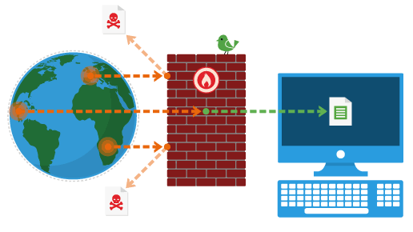

Slide 19
IP & Proxies
What is an IP address ?
What is a Mac address ?
What is a Proxy ?
[ Childish Slide Alert]

Slide 20
IP v4 & IP v6
How to change your IP ? -- VPNs
How to find location using IP ?
How to trace an email using IP ?

Slide 21
PROXY
[ Childish Slide Alert]
Psiphon
Anonymiser.ru
Anonymous-surfin.com
Hotspot shield
Tor browser

Slide 22
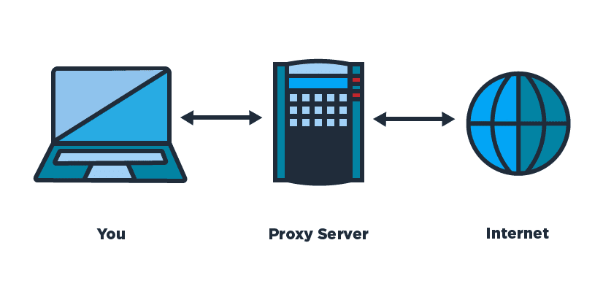

Slide 23
Enumeration
Another exaggerated security word.

Slide 24
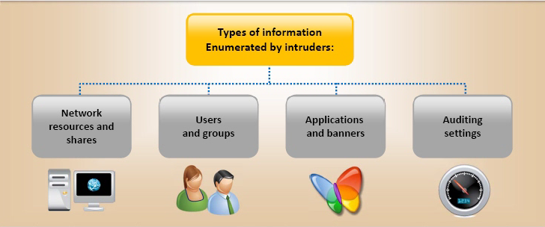

Slide 25
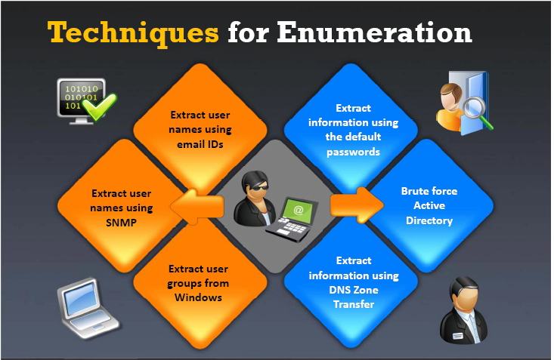

Slide 26
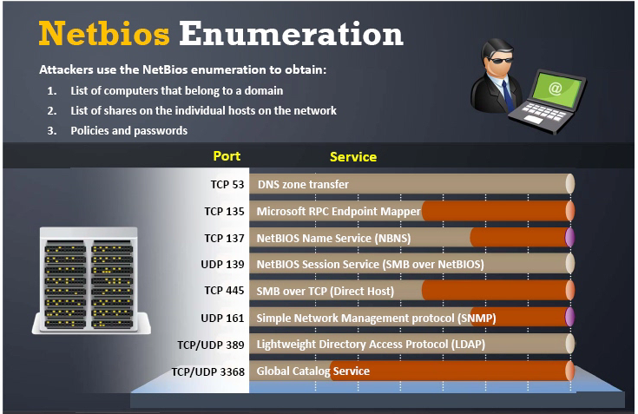

Slide 27
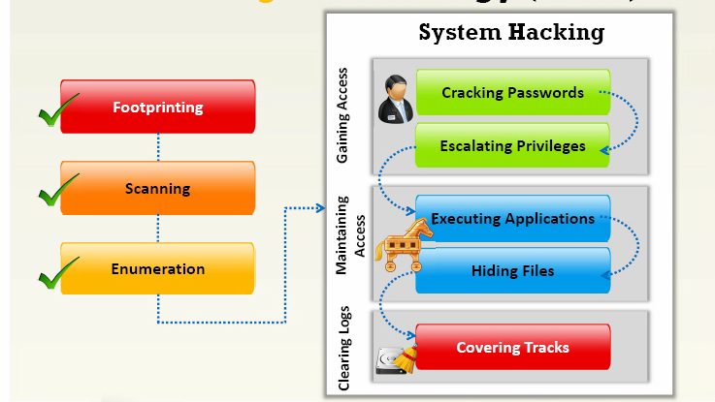

Slide 28
System & Password Hacking
[ Childish Slide Alert]
Brute force
Dictionary
Software
Key logger
Live boot
Linux -- Root Pswd Hacking through Boot.
Hardware -- Battery Removal

Slide 29
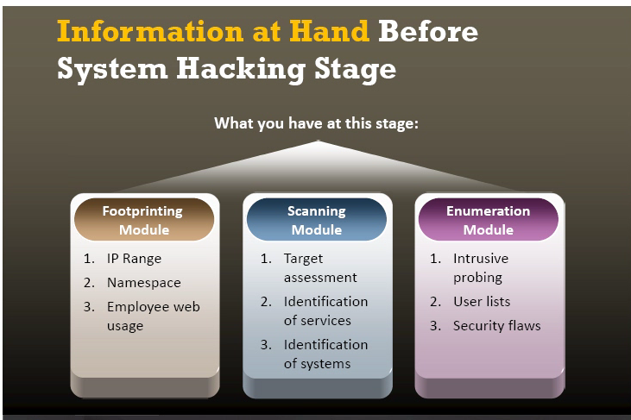

Slide 30
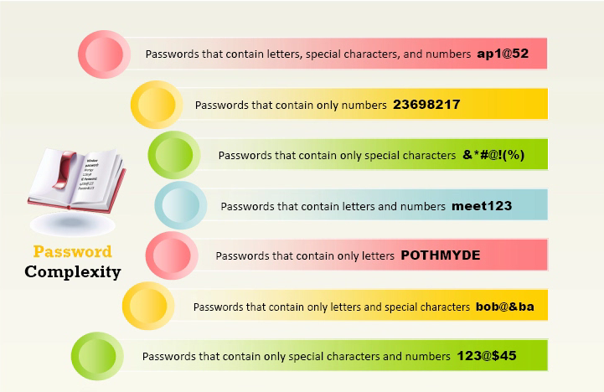

Slide 31
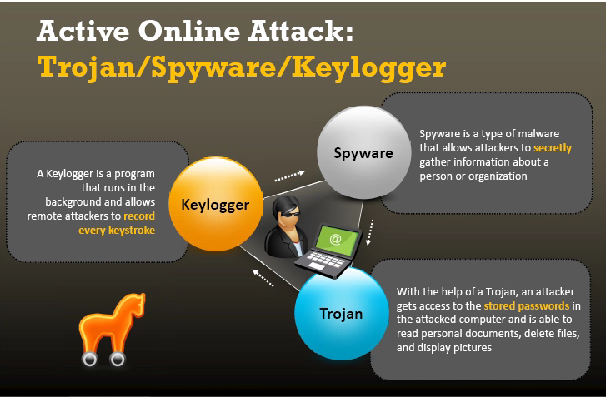

Slide 32
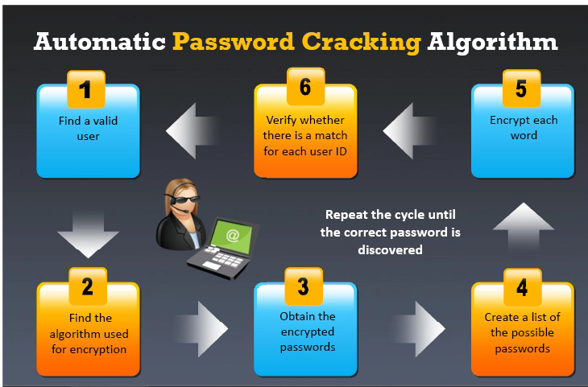

Slide 33
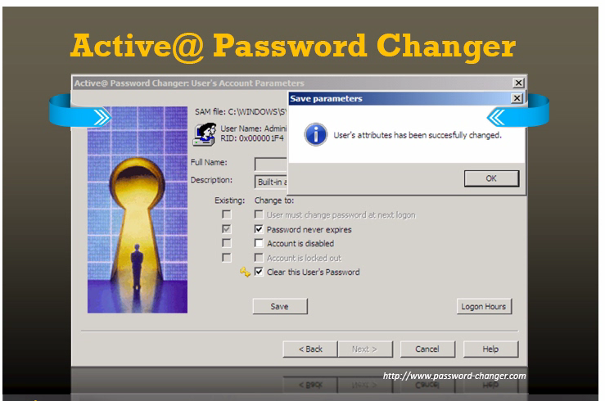

Slide 34
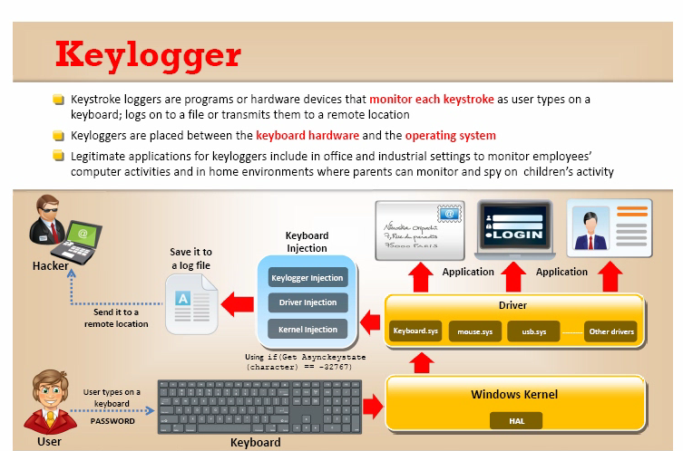

Slide 35
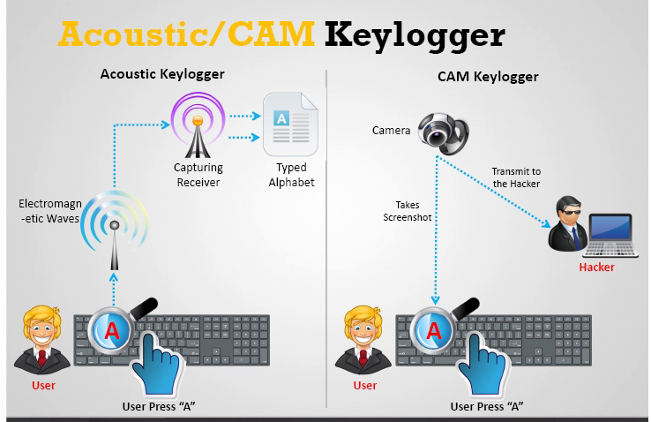

Slide 36
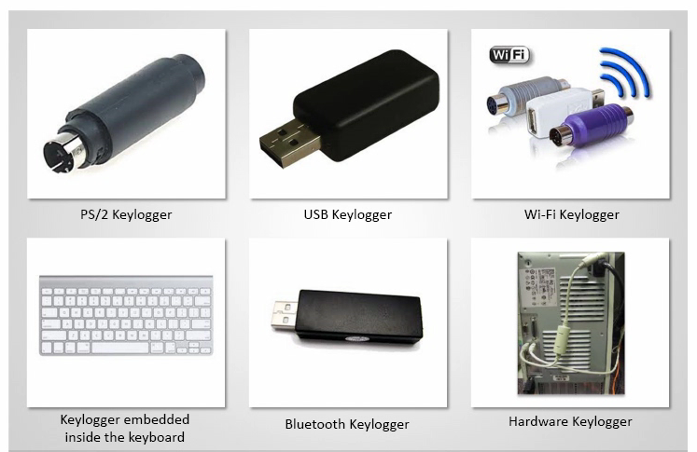

Slide 37
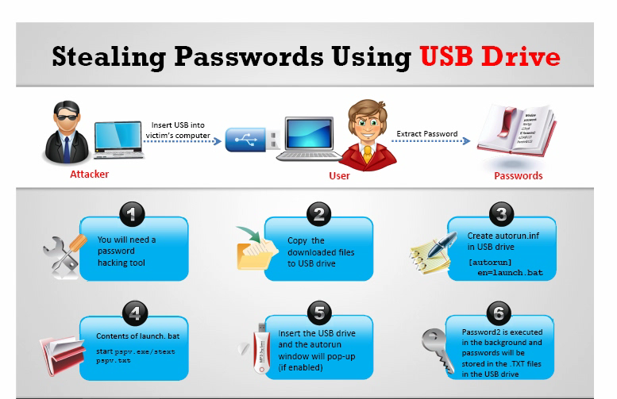

Slide 38
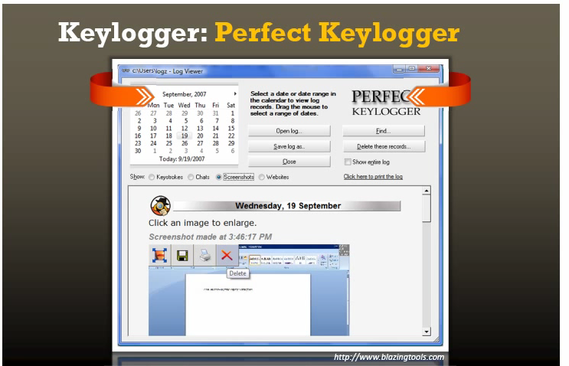

Slide 39
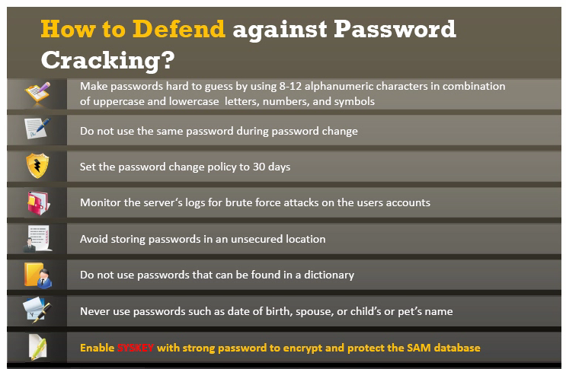

Slide 40
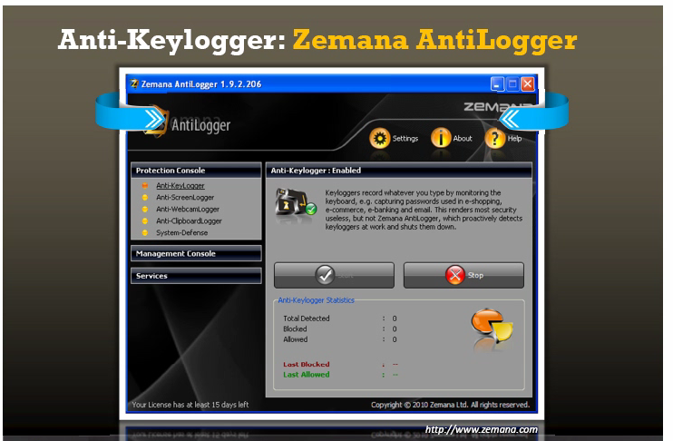

Slide 41
Spywares
[ Childish Slide Alert]

Slide 42
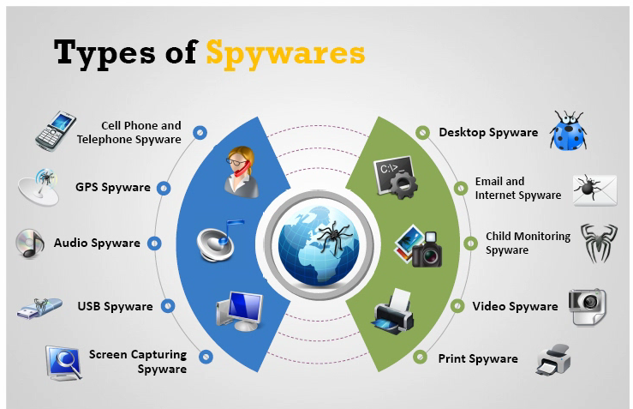

Slide 43
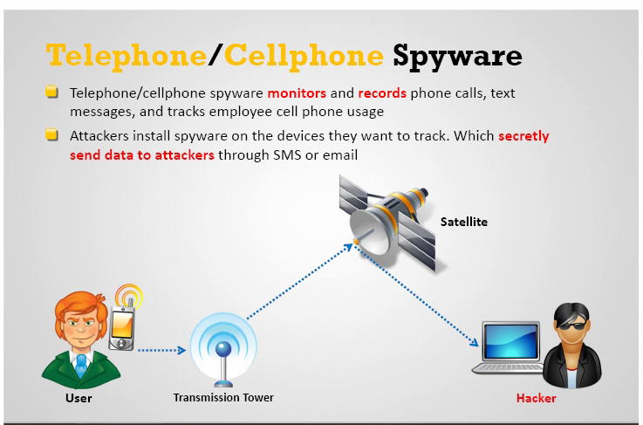

Slide 44
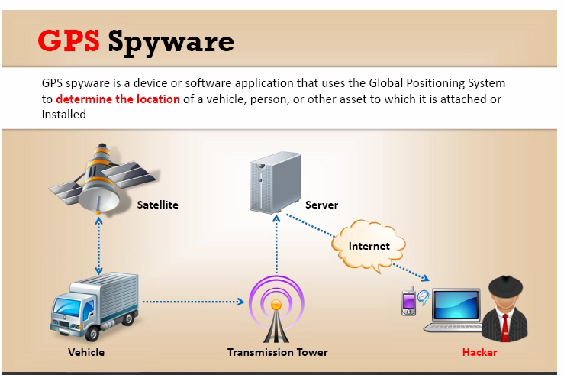

Slide 45
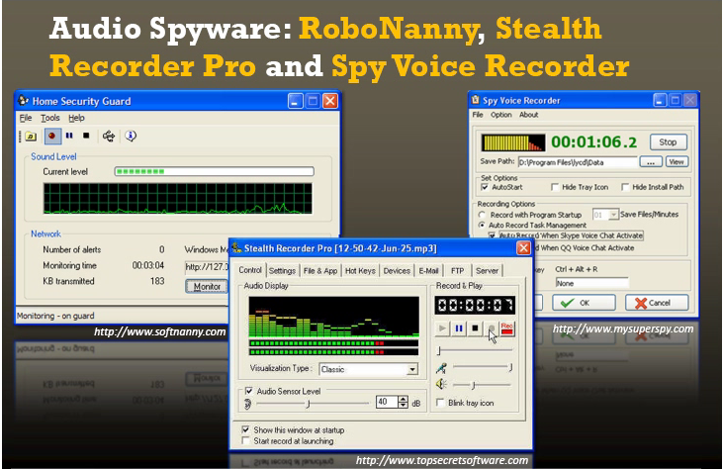

Slide 46
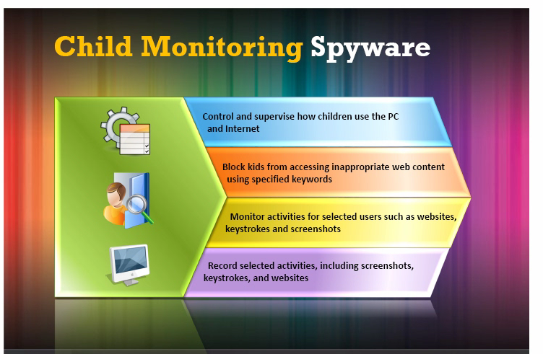

Slide 47
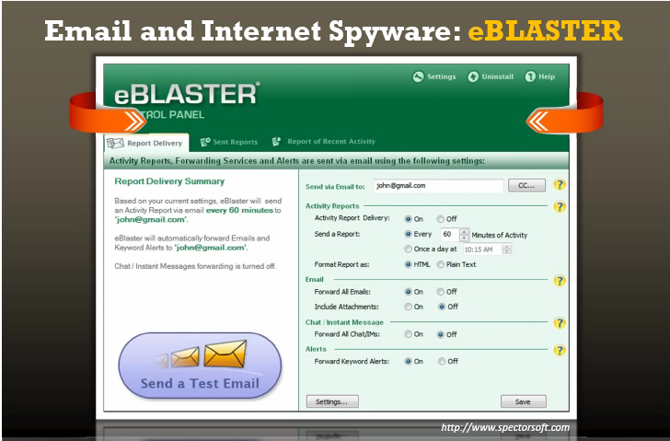

Slide 48
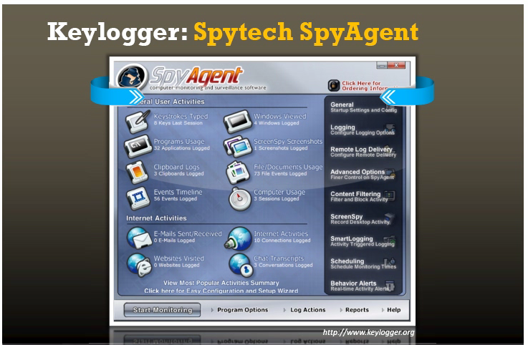

Slide 49
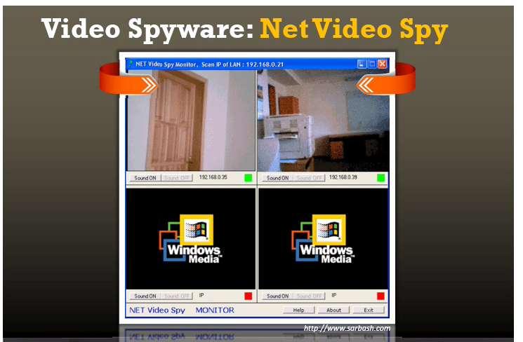

Slide 50
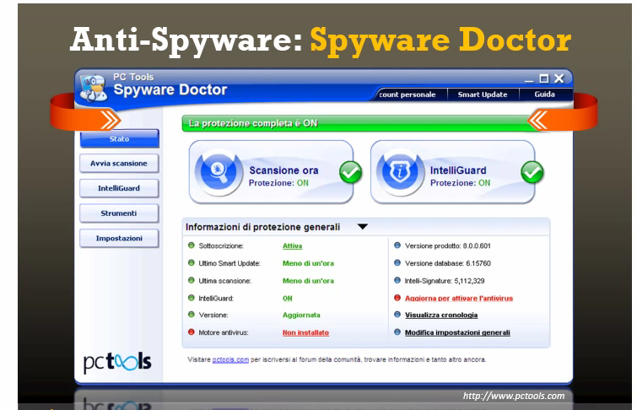

Slide 51
Trojans
Story Behind Trojans.
How do they work?
How Trojans come to the system?

Slide 52
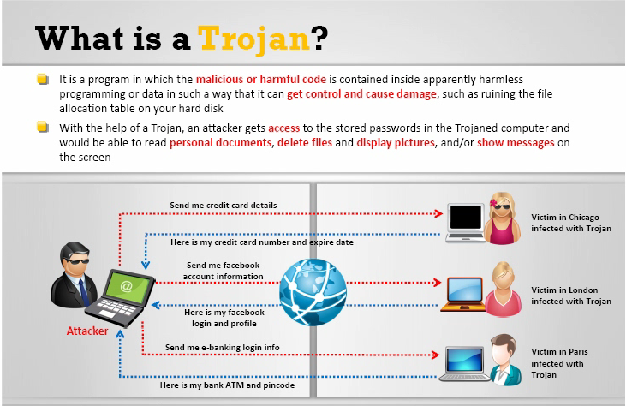

Slide 53
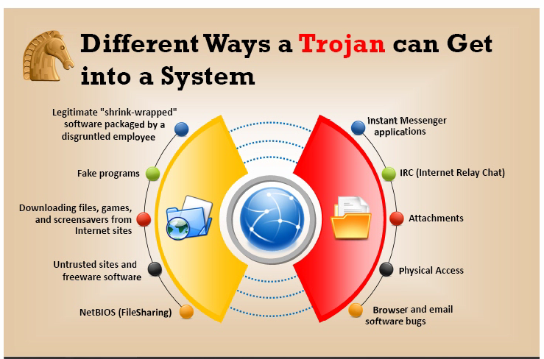

Slide 54
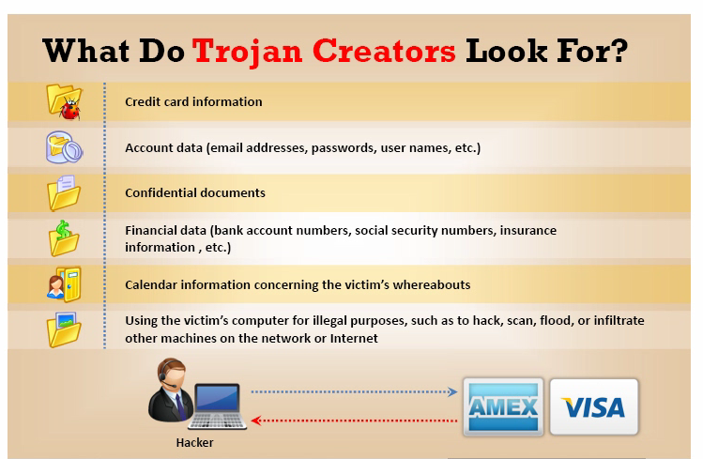

Slide 55
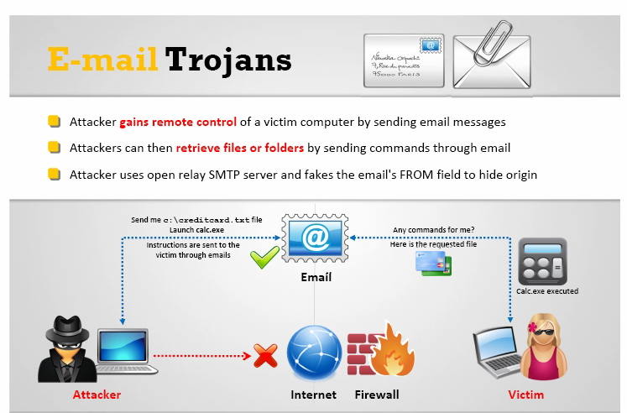

Slide 56
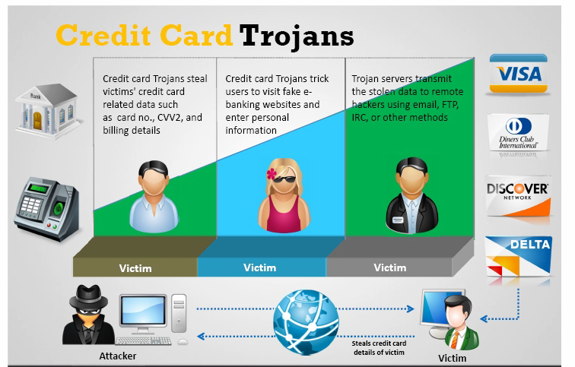

Slide 57
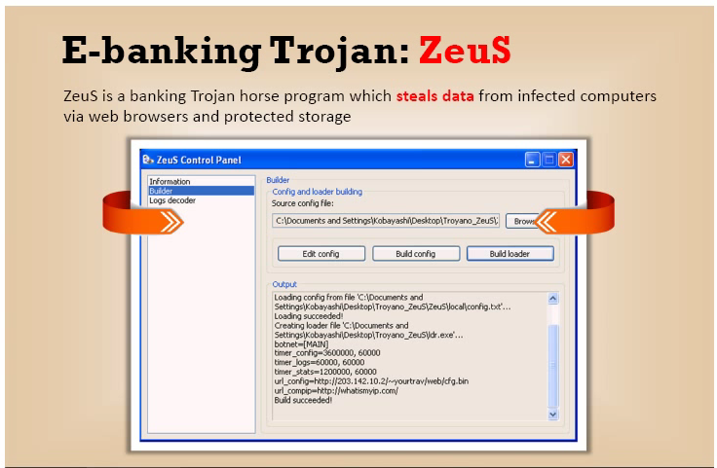

Slide 58
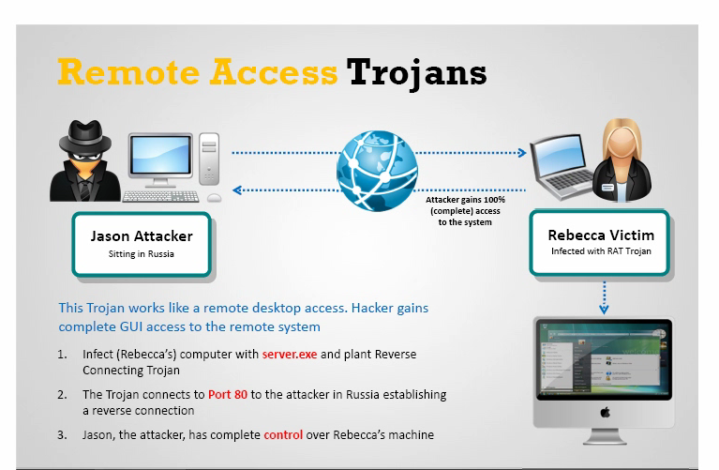

Slide 59
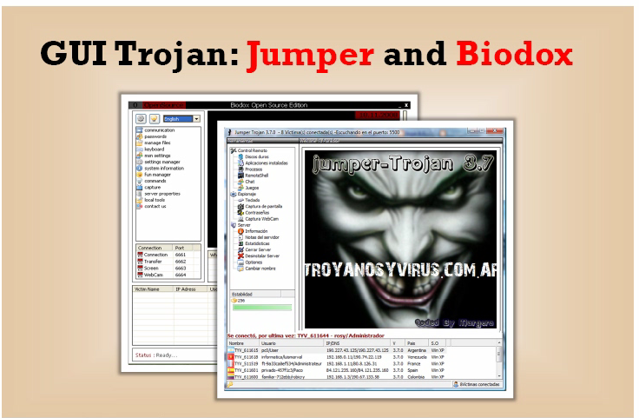

Slide 60
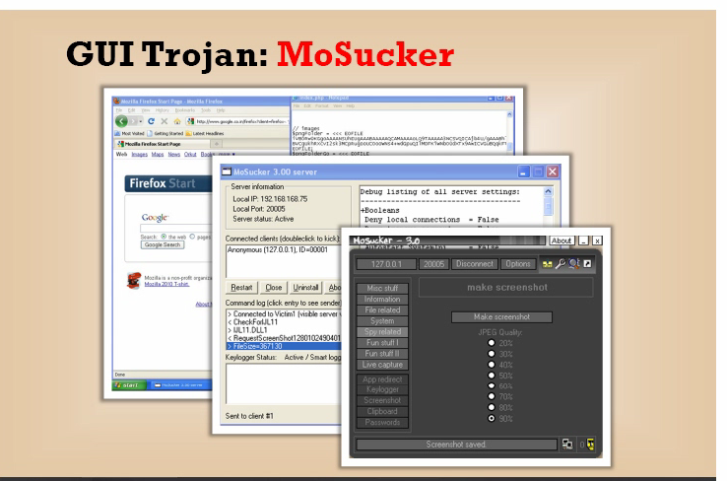

Slide 61
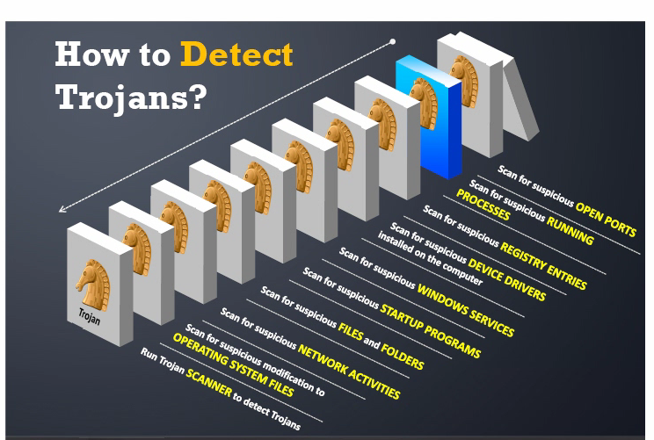

Slide 62
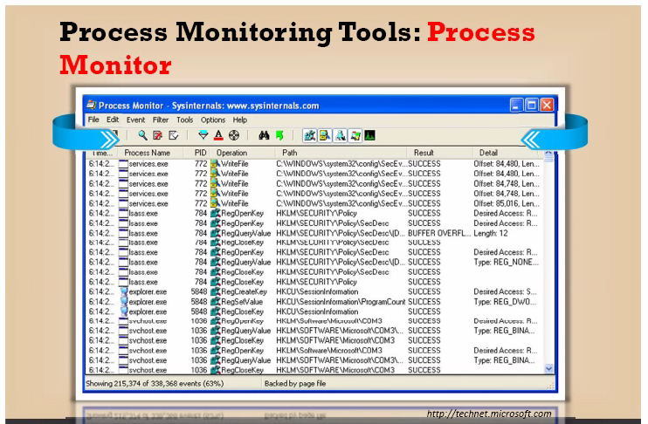

Slide 63
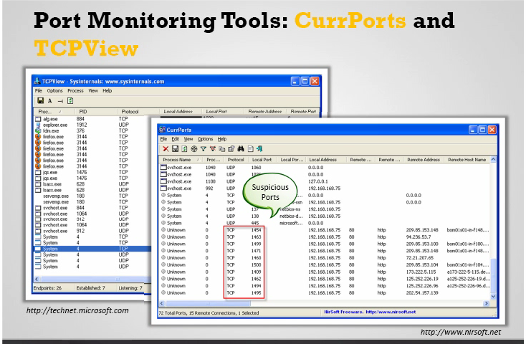

Slide 64
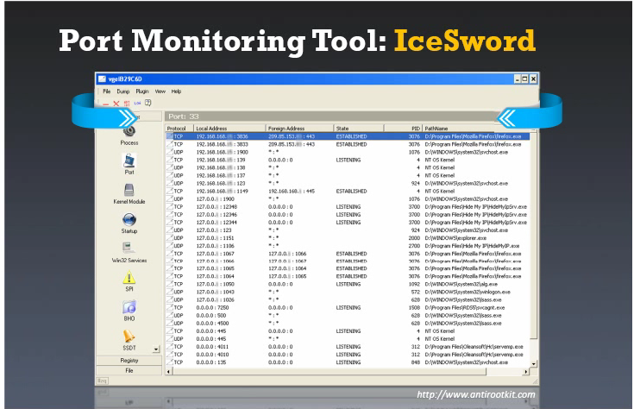

Slide 65
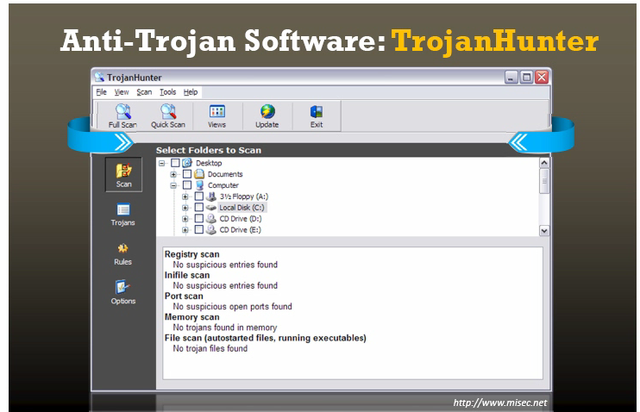

Slide 66
Remote Administration Tools [RATs]
[ Childish Slide Alert]

Slide 67
Viruses & Worms
[ Childish Slide Alert]

Slide 68
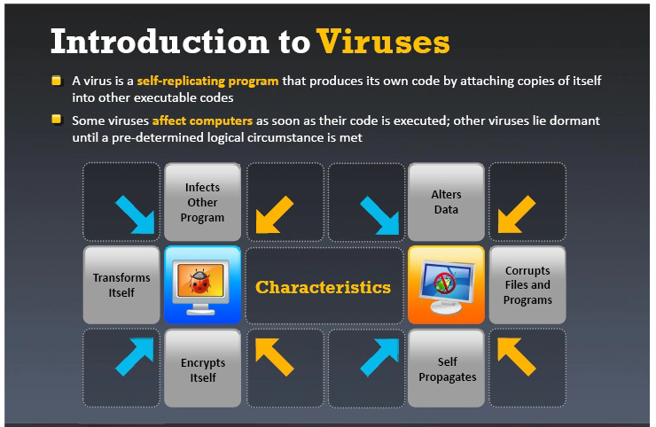

Slide 69
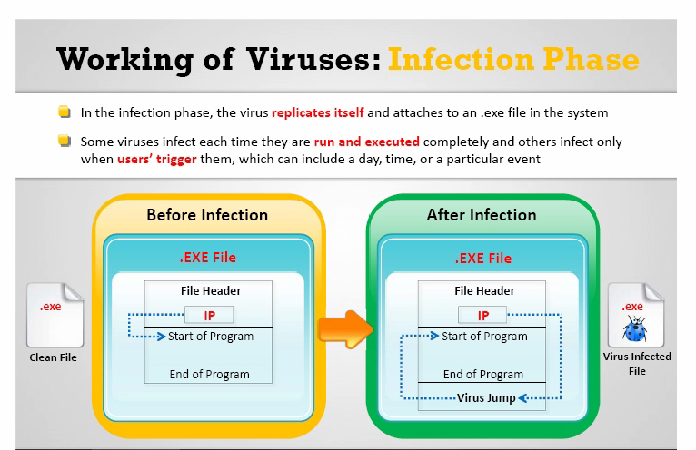

Slide 70
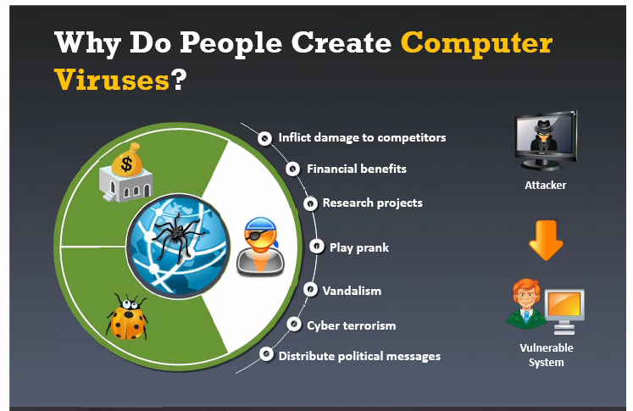

Slide 71
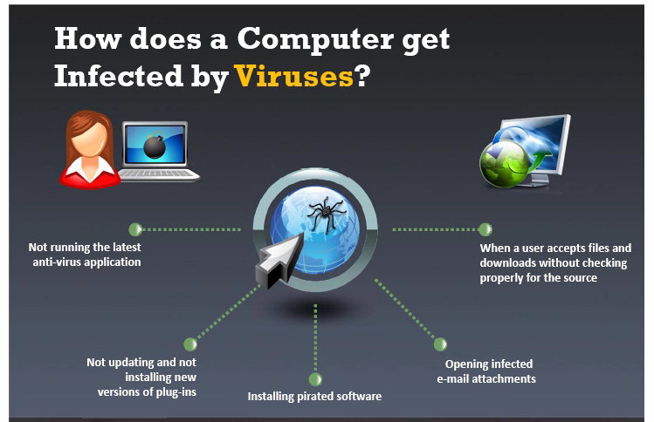

Slide 72
Types of viruses
System or boot sector viruses
File and multimedia viruses
Macro viruses
Cluster viruses
Encryption viruses
File extension viruses

Slide 73
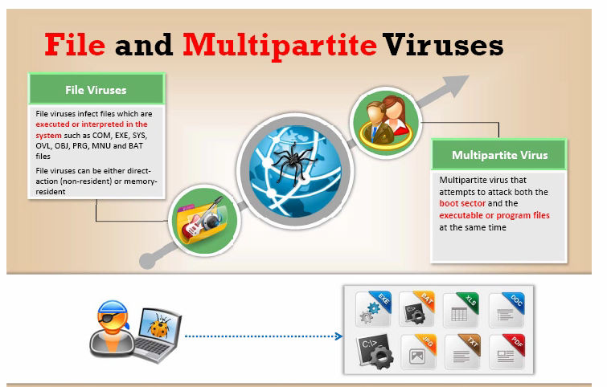

Slide 74
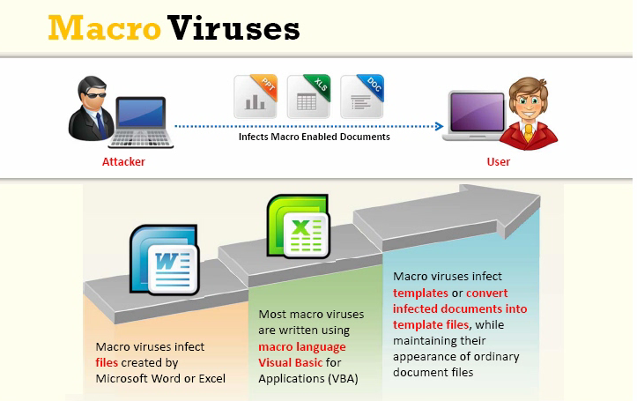

Slide 75
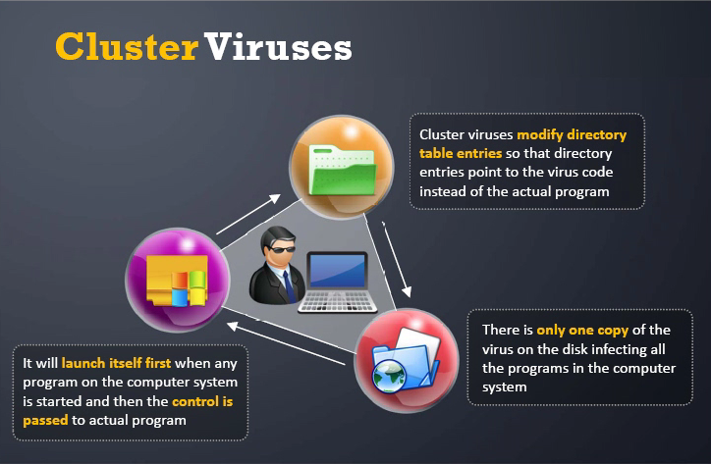

Slide 76
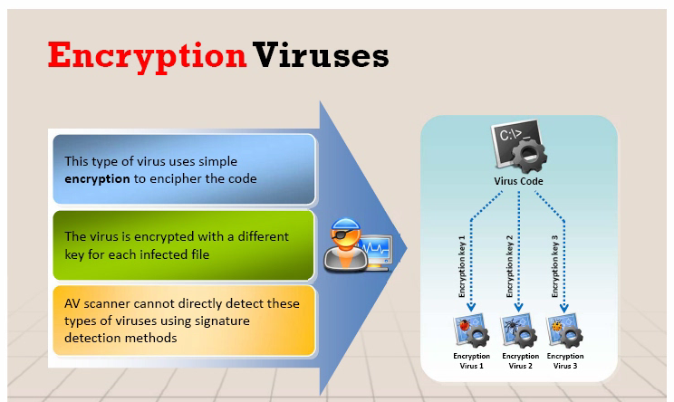

Slide 77
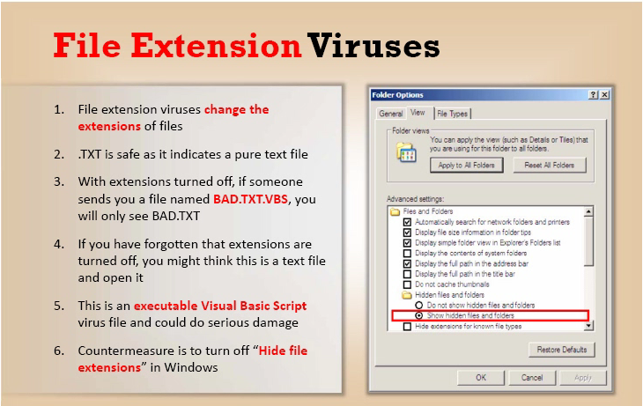

Slide 78
How to remove viruses from computer
Antiviruses sensor
Process monitor tool
Debugging tool
Installing antivirus
Scanning each file
Entry checking
Viruses and warm countermeasures

Slide 79


Slide 80


Slide 81


Slide 82
SNIFFING
{ Demonstration with Wireshark}

Slide 83


Slide 84


Slide 85


Slide 86


Slide 87


Slide 88
Wifi Hacking
{ Using Simple Wifite Framework}

Slide 89
System/Android Hacking
{ Using Metasploit Framework}

Slide 90
Hail Mary Attacks !
{ Using Armitage Framework}

Slide 91
Wifi Jamming
{ Using "mdk3 mon0 d" Framework}

Slide 92
Next-Gen Research Scopes
" If it's already advanced how we will progress with this futher ? "
Artificial Intuition
Artificial Immune Systems
Advanced Self-Driving Cars (Computer Vision)
Imaging Human Thoughts

Slide 93
Resources
www.Gitlab.com/Wahal
MrinalWahal@gmail.com
91 + 9560892906
PDFs
Cheat Sheets
Python Pre-Written Codes

Slide 94
Let's Distribute Links !
SANS Institute
Hacking Tools/Books Mega Link
NMap Documentation
Offensive Security Pages
Kali Images

Slide 95
" In foreign sand, your knowledge is your rich possession. In the battlefield, your practical skills are your rich possession. Inside home, your wife/husband is your rich possession. On the death bed, the most efficacious medicine is your rich possession. But throughout life and beyond, your Dharma is your Kohinoor. "
~ Chanakya

